Slide 1
Free Food Friend
Tarika Bedse
Sambriddhi Mainali
Qiong Yu
Customer – Lei Pi

Slide 2
Overview
This project will solve the problem by designing a website where users can easily submit and view information of upcoming free food events on campus.
The purpose is to make it easy to find free food.

Slide 3
Features
User account (Registration, Login, Logout)
Publish free food events, edit event page
Browse free food events, Detailed information of events
Search free food events (Filter, Sort, History)
Comment and score on free food events attended

Slide 4
Contd.
Show search result summary
Remind confliction of the events
View number of attendants and maximums

Slide 5
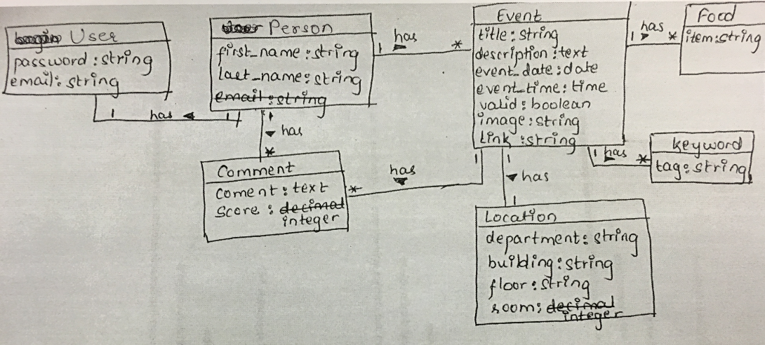
Class diagram

Slide 6


Slide 7
